Slide 1
Internet Backbone
Antonio Virdis
Assistant Professor@ University of Pisa
antonio.virdis@unipi.it

Slide 2
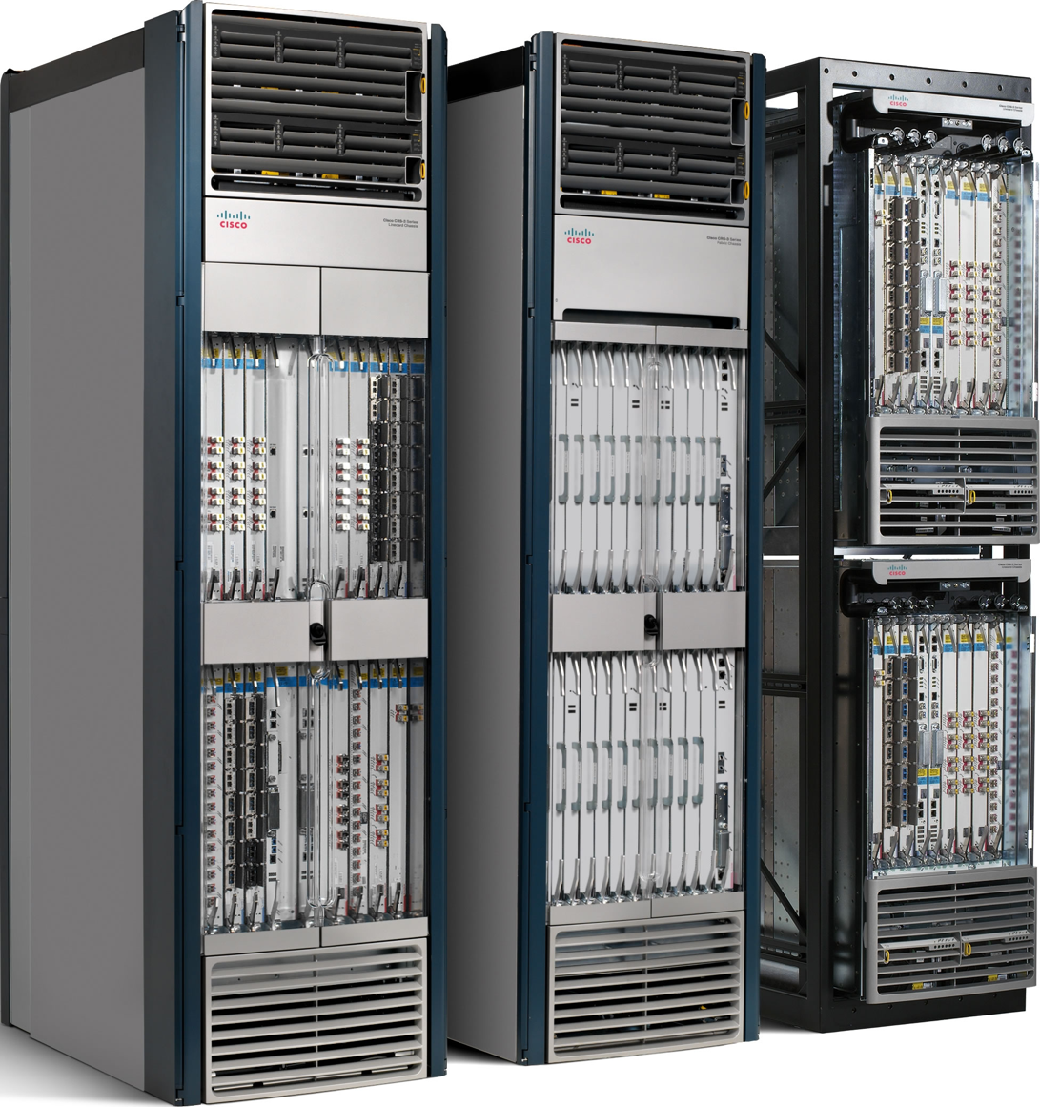
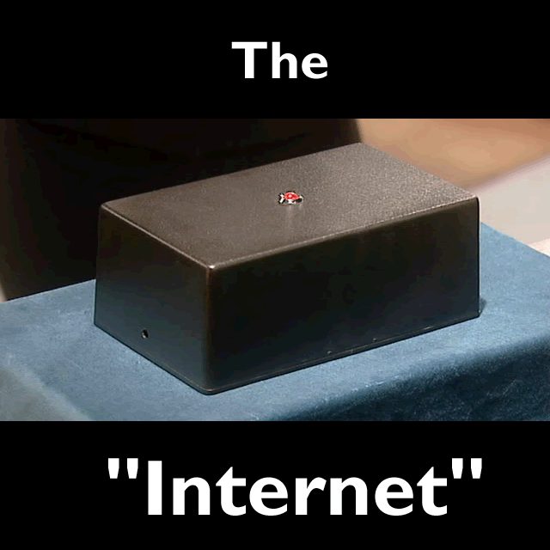
Internet Backbone architecture
https://www.youtube.com/watch?v=iDbyYGrswtg

Slide 3
Outline
Introduction to GNS3
Basic commands for CISCO routers configuration
MPLS

Slide 4
Cisco IOS: Basic commands
Antonio Virdis
Assistant Professor@ University of Pisa
antonio.virdis@unipi.it

Slide 5
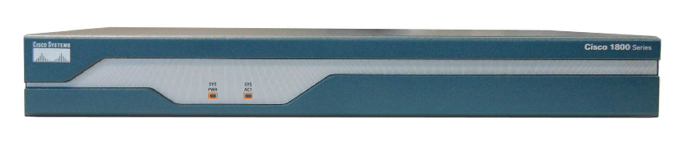
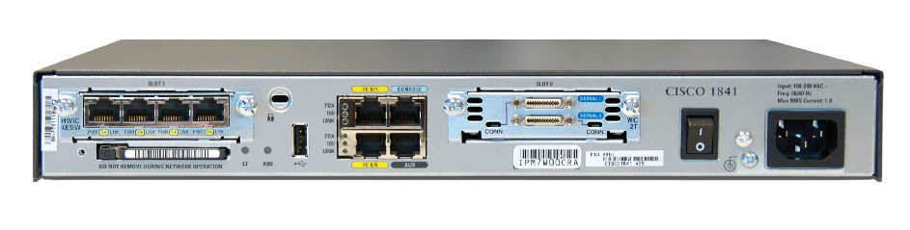
Routers are “specialized” computers
Notes:
All protocols you learned so far need to be executed by something.
Their hardware is build on purpose to manage packet forwarding and rerouting

Slide 6
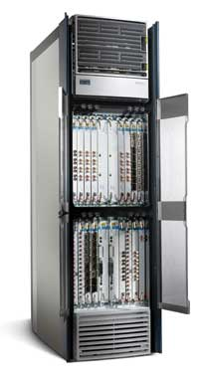
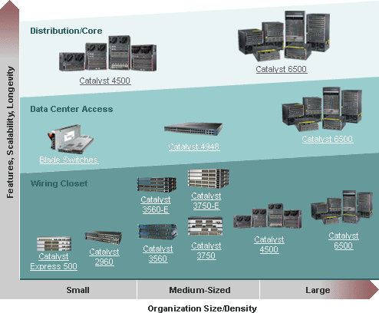
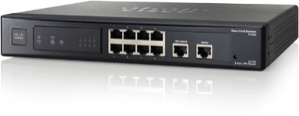
From small to big
Notes:
Their hardware is build on purpose to manage packet forwarding and rerouting
Moving from the routers installed inside big offices to the internet backbone the size of the router increases as well as the number of the interfaces and the amount of traffic to be handled
As the amount of traffic to be handled increases, the hardware gets more specialized implementing more and more functions directly in hardware to increase its efficiency

Slide 7
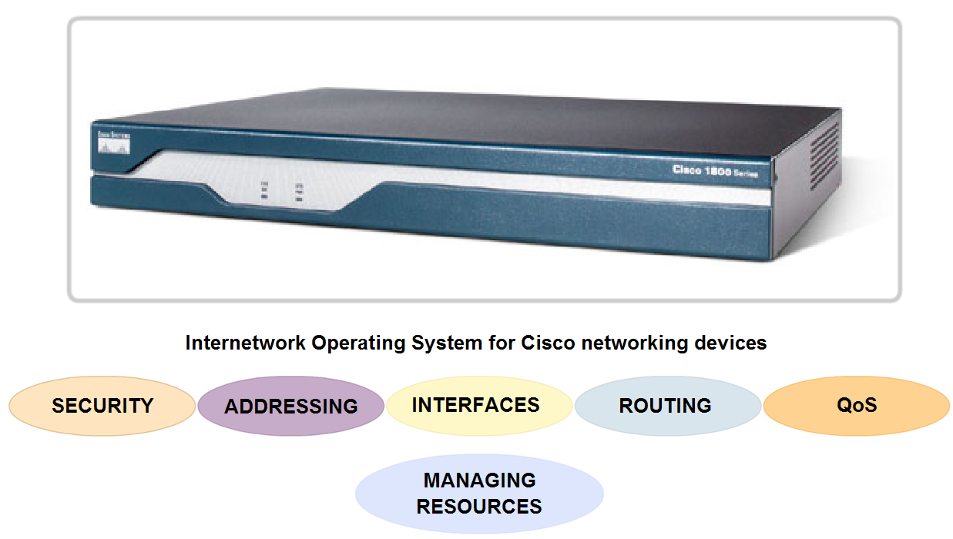
The operating system
Cisco Internetwork Operating System (IOS)
Juniper Network Operating System (Junos)
…
Notes:
Similar to a personal computer, a router or switch cannot function without an operating system. Without an operating system, the hardware does not have any capabilities. The Cisco Internetwork Operating System (IOS) is the system software in Cisco devices. It is the core technology that extends across most of the Cisco product line. The Cisco IOS is used for most Cisco devices regardless of the size and type of the device. It is used for routers, LAN switches, small Wireless Access Points, large routers with dozens of interfaces, and many other devices.
The Cisco IOS provides devices with the following network services:
Basic routing and switching functions
Reliable and secure access to networked resources
Network scalability
The IOS operational details vary on different internetworking devices, depending on the device's purpose and feature set.
The services provided by the Cisco IOS are generally accessed using a command line interface (CLI). The features accessible via the CLI vary based on the version of the IOS and the type of device.
The IOS file itself is several megabytes in size and is stored in a semi-permanent memory area called flash. Flash memory provides non-volatile storage. This means that the contents of the memory are not lost when the device loses power. Even though the contents are not lost they can be changed or overwritten if needed.
Using flash memory allows the IOS to be upgraded to newer versions or to have new features added. In many router architectures, the IOS is copied into RAM when the device is powered on and the IOS runs from RAM when the device is operating. This function increases the performance of the device.

Slide 8


Nodes configuration
Network admin

Slide 9
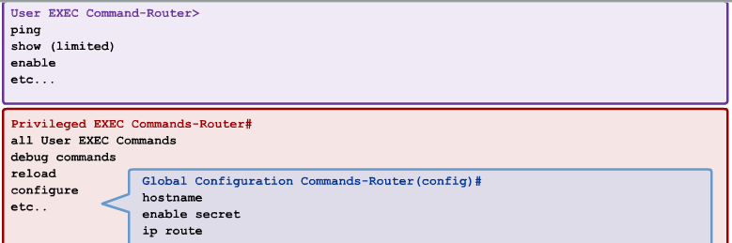
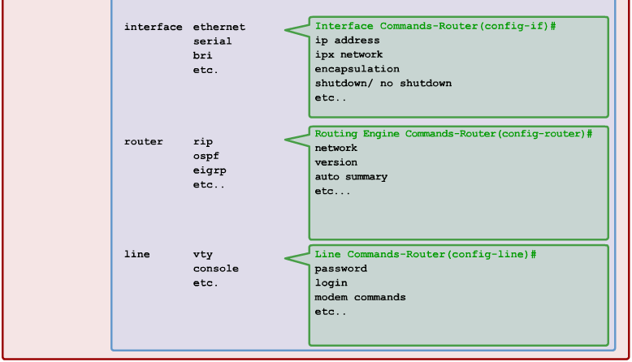
Cisco IOS modes
Notes:
The Cisco IOS is designed as a modal operating system. The term modal describes a system where there are different modes of operation, each having its own domain of operation. The CLI uses a hierarchical structure for the modes.
In order from top to bottom, the major modes are:
User executive mode
Privileged executive mode
Global configuration mode
Other specific configuration modes
Each mode is used to accomplish particular tasks and has a specific set of commands that are available when in that mode. For example, to configure a router interface, the user must enter interface configuration mode. All configurations that are entered in interface configuration mode apply only to that interface.
Some commands are available to all users; others can be executed only after entering the mode in which that command is available. Each mode is distinguished with a distinctive prompt, and only commands that are appropriate for that mode are allowed.
The hierarchical modal structure can be configured to provide security. Different authentication can be required for each hierarchical mode. This controls the level of access that network personnel can be granted.
The figure shows the IOS modal structure with typical prompts and features.

Slide 10
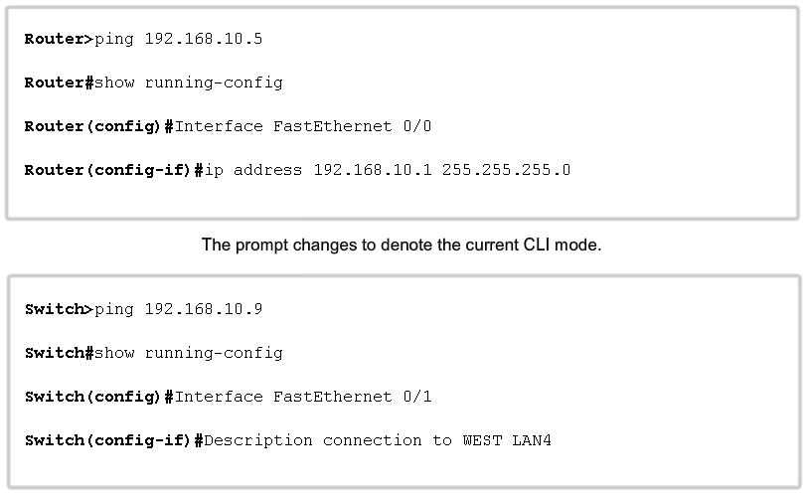
IOS prompt structure
Notes:
Command Prompts
When using the CLI, the mode is identified by the command-line prompt that is unique to that mode. The prompt is composed of the words and symbols on the line to the left of the entry area. The word prompt is used because the system is prompting you to make an entry.
By default, every prompt begins with the device name. Following the name, the remainder of the prompt indicates the mode. For example, the default prompt for the global configuration mode on a router would be:
Router(config)#
As commands are used and modes are changed, the prompt changes to reflect the current context, as shown in the figure.

Slide 11
Moving between primary modes
Router con0 in now available.
Press RETURN to get started.
User Access Verification
Password:
Router>enable
Password:
Router#configure terminal
Enter configuration commands, one per line. End with CNTL/Z.
Router(config)#^Z
Router#disable
Router>exit
Notes:
The enable and disable commands are used to change the CLI between the user EXEC mode and the privileged EXEC mode, respectively.
In order to access the privileged EXEC mode, use the enable command. The privileged EXEC mode is sometimes called the enable mode.
The syntax for entering the enable command is:
Router>enable
This command is executed without the need for an argument or keyword. Once <Enter> is pressed, the router prompt changes to:
Router#
The # at the end of the prompt indicates that the router is now in privileged EXEC mode.
If password authentication has been configured for the privileged EXEC mode, the IOS prompts for the password.
For example:
Router>enable
Password:
Router#
The disable command is used to return from the privileged EXEC to the user EXEC mode.
For example:
Router#disable
Router>

Slide 12
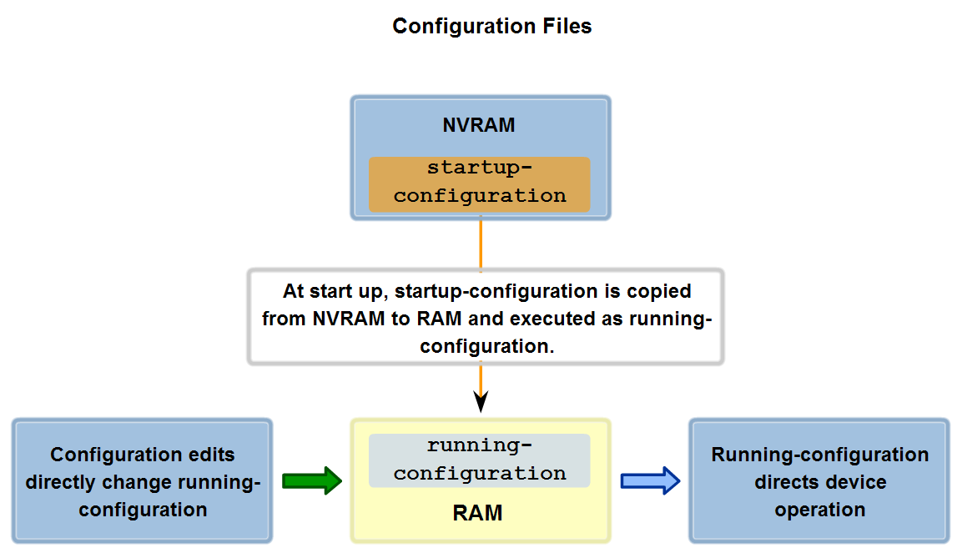
Configuration files
Notes:
Network devices depend on two types of software for their operation: operating system and configuration. Like the operating system in any computer, the operating system facilitates the basic operation of the device's hardware components.
Configuration files contain the Cisco IOS software commands used to customize the functionality of a Cisco device. Commands are parsed (translated and executed) by the Cisco IOS software when the system is booted (from the startup-config file) or when commands are entered in the CLI while in configuration mode.
A network administrator creates a configuration that defines the desired functionality of a Cisco device. The configuration file is typically a few hundred to a few thousand bytes in size.
Types of Configuration Files
A Cisco network device contains two configuration files:
The running configuration file - used during the current operation of the device
The startup configuration file - used as the backup configuration and is loaded when the device is started
A configuration file may also be stored remotely on a server as a backup.
Startup Configuration File
The startup configuration file (startup-config) is used during system startup to configure the device. The startup configuration file or startup-config file is stored in non-volatile RAM (NVRAM). Since NVRAM is non-volatile, when the Cisco device is turned off, the file remains intact. The startup-config files are loaded into RAM each time the router is started or reloaded. Once the configuration file is loaded into RAM, it is considered the running configuration or running-config.
Running Configuration
Once in RAM, this configuration is used to operate the network device.
The running configuration is modified when the network administrator performs device configuration. Changes to the running configuration will immediately affect the operation of the Cisco device. After making any changes, the administrator has the option of saving those changes back to the startup-config file so that they will be used the next time the device restarts.
Because the running configuration file is in RAM, it is lost if the power to the device is turned off or if the device is restarted. Changes made to the running-config file will also be lost if they are not saved to the startup-config file before the device is powered down.

Slide 13
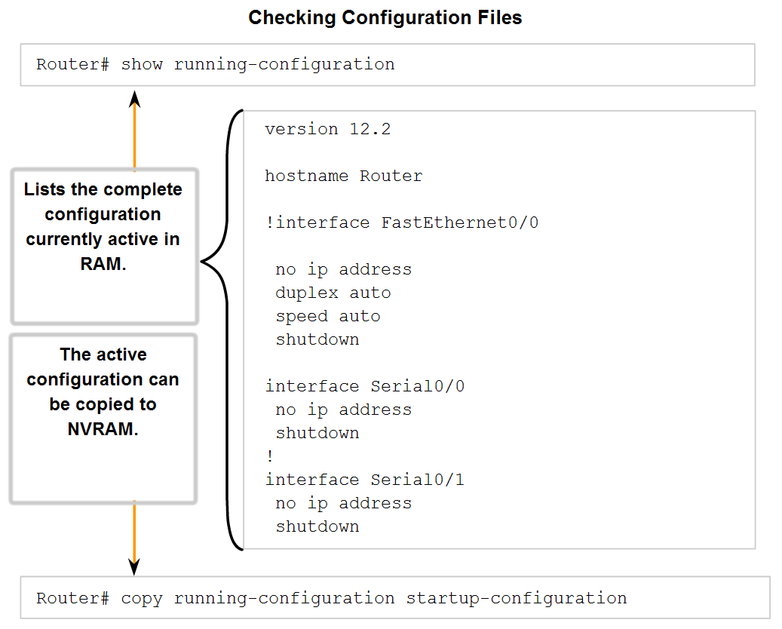
Managing configuration files
Notes:
As we have discussed, modifying a running configuration affects the operation of the device immediately.
After making changes to a configuration, consider these options for the next step:
Make the changed configuration the new startup configuration.
Return the device to its original configuration.
Remove all configuration from the device.
Make the Changed Configuration the New Startup Configuration
Remember, because the running configuration is stored in RAM, it is temporarily active while the Cisco device is running (powered on). If power to the router is lost or if the router is restarted, all configuration changes will be lost unless they have been saved.
Saving the running configuration to the startup configuration file in NVRAM preserves the changes as the new startup configuration.
Before committing to the changes, use the appropriate show commands to verify the device's operation. As shown in the figure, the show running-config command can be used to see a running configuration file.
When the changes are verified to be correct, use the copy running-config startup-config command at the privileged EXEC mode prompt. The following example shows the command:
Switch#copy running-config startup-config
Once executed, the running configuration file replaces the startup configuration file.
Return the Device to Its Original Configuration (QUESTO MOSTRARLO SUL TERMINALE)
If the changes made to the running configuration do not have the desired effect, it may become necessary to restore the device to its previous configuration. Assuming that we have not overwritten the startup configuration with the changes, we can replace the running configuration with the startup configuration. This is best done by restarting the device using the reload command at the privileged EXEC mode prompt.
When initiating a reload, the IOS will detect that the running config has changes that were not saved to startup configuration. A prompt will appear to ask whether to save the changes made. To discard the changes, enter n or no.
An additional prompt will appear to confirm the reload. To confirm, press the Enter key. Pressing any other key will abort the process.
For example:
Router#reload
System configuration has been modified. Save? [yes/no]: n
Proceed with reload? [confirm]
*Apr 13 01:34:15.758: %SYS-5-RELOAD: Reload requested by console. Reload Reason:
Reload Command.
System Bootstrap, Version 12.3(8r)T8, RELEASE SOFTWARE (fc1)
Technical Support: http://www.cisco.com/techsupport
Copyright (c) 2004 by cisco Systems, Inc.
PLD version 0x10
GIO ASIC version 0x127
c1841 processor with 131072 Kbytes of main memory
Main memory is configured to 64 bit mode with parity disabled

Slide 14
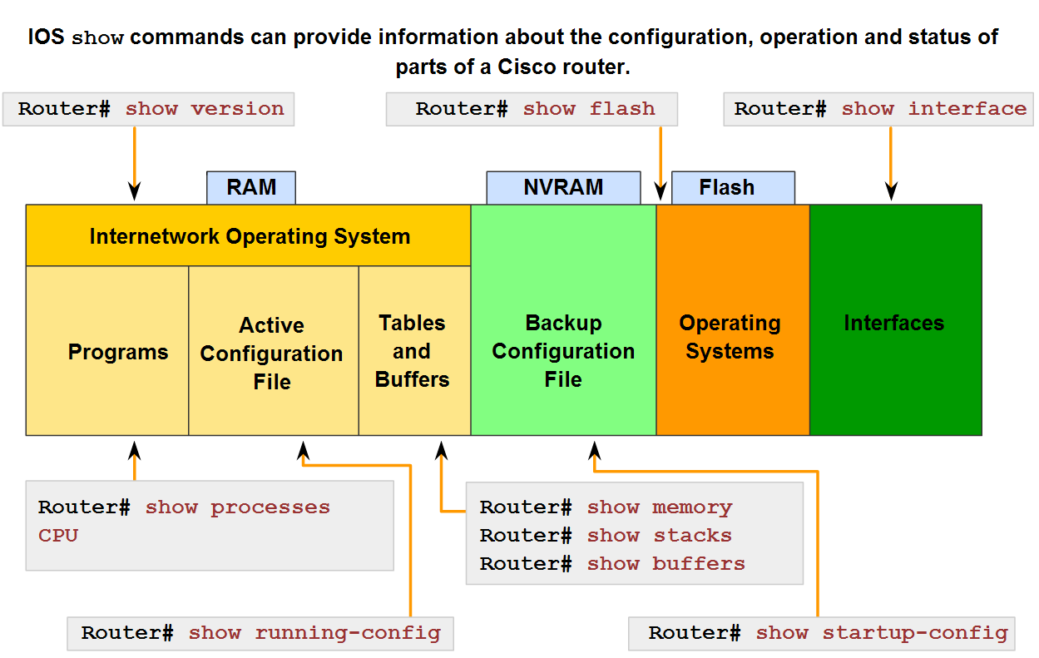
The IOS show command
Notes:
In order to verify and troubleshoot network operation, we must examine the operation of the devices. The basic examination command is the show command.
There are many different variations of this command. As you develop more skill with the IOS, you will learn to use and interpret the output of the show commands. Use the show ? command to get a list of available commands in a given context, or mode.
The figure indicates how the typical show command can provide information about the configuration, operation, and status of parts of a Cisco router.
In this course, we use some of the more basic show commands.

Slide 15
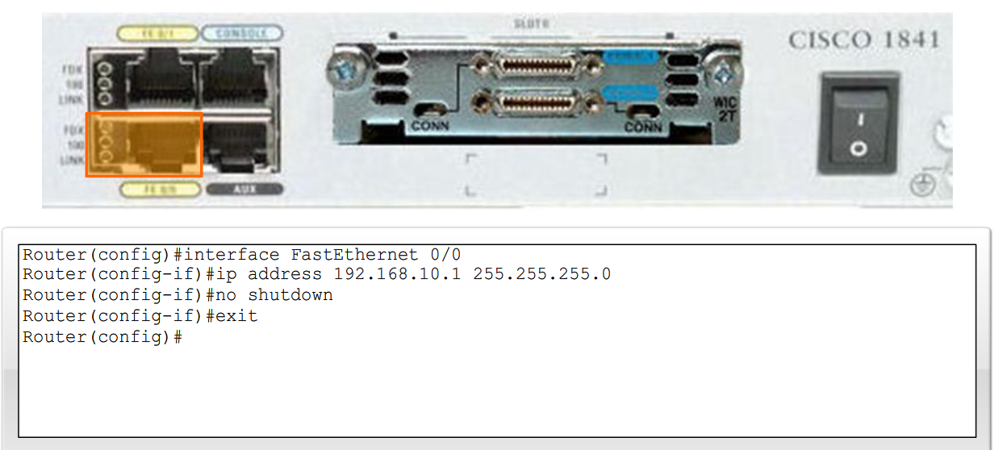
Configuring Ethernet interfaces
Notes:
Router Ethernet interfaces are used as the gateways for the end devices on the LANs directly connected to the router.
Each Ethernet interface must have an IP address and subnet mask to route IP packets.
To configure an Ethernet interface follow these steps:
Enter global configuration mode.
Enter interface configuration mode.
3. Specify the interface address and subnet mask.
4. Enable the interface.
As shown in the figure, configure the Ethernet IP address using the following commands:
Router(config)#interface FastEthernet 0/0
Router(config-if)#ip address ip_address netmask
Router(config-if)#no shutdown
Enabling the Interface
By default, interfaces are disabled. To enable an interface, enter the no shutdown command from the interface configuration mode. If an interface needs to be disabled for maintenance or troubleshooting, use the shutdown command.

Slide 16
GNS3
Graphical Network Simulator 3 is a network software emulator
It allows the combination of virtual and real devices to emulate complex networks
Specifically it allows the emulation of real hosts and real routers
The emulated routers run a real IoS image downloaded from a real router

Slide 17
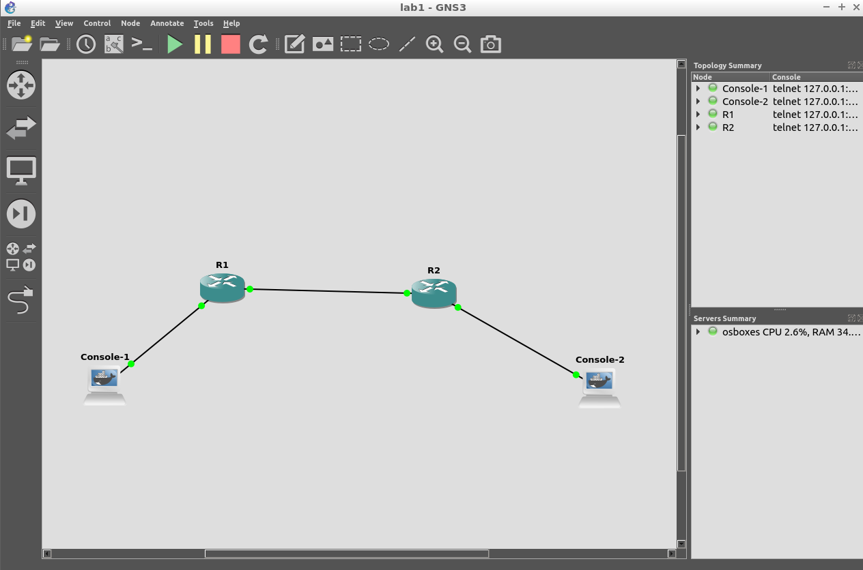

Slide 18
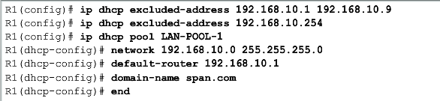
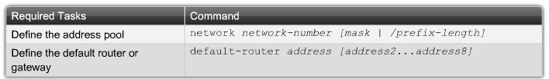
Configure a DHCP server on a router
Define a range of addresses that DHCP is not to allocate
static addresses reserved for the router interface, switch management IP address, servers, and local network printers
Create the DHCP pool
Configure the specifics of the pool.
Notes:
Cisco routers running Cisco IOS software provide full support for a router to act as a DHCP server. The Cisco IOS DHCP server assigns and manages IP addresses from specified address pools within the router to DHCP clients.
The steps to configure a router as a DHCP server are as follows:
Step 1. Define a range of addresses that DHCP is not to allocate. These are usually static addresses reserved for the router interface, switch management IP address, servers, and local network printers.
Step 2. Create the DHCP pool using the ip dhcp pool command.
Step 3. Configure the specifics of the pool.
You should specify the IP addresses that the DHCP server should not assign to clients. Typically, some IP addresses belong to static network devices, such as servers or printers. DHCP should not assign these IP addresses to other devices. A best practice is to configure excluded addresses in global configuration mode before creating the DHCP pool. This ensures that DHCP does not assign reserved addresses accidentally. To exclude specific addresses, use the ip dhcp excluded-address command.
Configuring a DHCP server involves defining a pool of addresses to assign. The ip dhcp pool command creates a pool with the specified name and puts the router in DHCP configuration mode, which is identified by the Router(dhcp-config)# prompt.
This figure lists the tasks to complete the DHCP pool configuration. Some of these are optional, while others must be configured.
You must configure the available addresses and specify the subnet network number and mask of the DHCP address pool. Use the network statement to define the range of available addresses.
You should also define the default gateway or router for the clients to use with the default-router command. Typically, the gateway is the LAN interface of the router. One address is required, but you can list up to eight addresses.
The next DHCP pool commands are considered optional. For example, you can configure the IP address of the DNS server that is available to a DHCP client using the dns-server command. When configured, one address is required, but up to eight addresses can be listed.
Other parameters include configuring the duration of the DHCP lease. The default setting is one day, but you can change this by using the lease command. You can also configure a NetBIOS WINS server that is available to a Microsoft DHCP client. Usually, this would be configured in an environment that supports pre-Windows 2000 clients. Because most installations now have clients with newer Windows operating system, this parameter is usually not required.
Disabling DHCP
The DHCP service is enabled by default on versions of Cisco IOS software that support it. To disable the service, use the no service dhcp command. Use the service dhcp global configuration command to re-enable the DHCP server process. Enabling the service has no effect if the parameters are not configured.

Slide 19
Test 1
Create a simple network composed of at least two routers and two hosts
Boot the routers
Configure the IP addresses of all the interfaces in the routers
Set two DHCP servers to autoconfigure IPv4 address to the hosts
Boot the hosts
Notes:
show ip interface brief

Slide 20
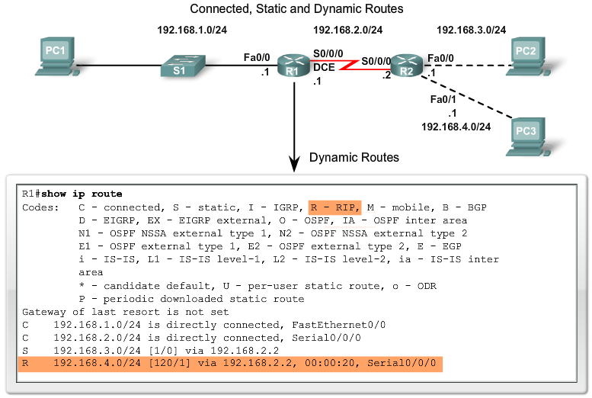
Routing table
Notes:
Dynamic Routing
Remote networks can also be added to the routing table by using a dynamic routing protocol. In the figure, R1 has automatically learned about the 192.168.4.0/24 network from R2 through the dynamic routing protocol, RIP (Routing Information Protocol). RIP was one of the first IP routing protocols and will be fully discussed in later chapters.
Note: R1's routing table in the figure shows that R1 has learned about two remote networks: one route that dynamically used RIP and a static route that was configured manually. This is an example of how routing tables can contain routes learned dynamically and configured statically and is not necessarily representative of the best configuration for this network.
Dynamic routing protocols are used by routers to share information about the reachability and status of remote networks. Dynamic routing protocols perform several activities, including:
Network discovery
Updating and maintaining routing tables
Automatic Network Discovery
Network discovery is the ability of a routing protocol to share information about the networks that it knows about with other routers that are also using the same routing protocol. Instead of configuring static routes to remote networks on every router, a dynamic routing protocol allows the routers to automatically learn about these networks from other routers. These networks - and the best path to each network - are added to the router's routing table and denoted as a network learned by a specific dynamic routing protocol.
Maintaining Routing Tables
After the initial network discovery, dynamic routing protocols update and maintain the networks in their routing tables. Dynamic routing protocols not only make a best path determination to various networks, they will also determine a new best path if the initial path becomes unusable (or if the topology changes). For these reasons, dynamic routing protocols have an advantage over static routes. Routers that use dynamic routing protocols automatically share routing information with other routers and compensate for any topology changes without involving the network administrator.
IP Routing Protocols
There are several dynamic routing protocols for IP. Here are some of the more common dynamic routing protocols for routing IP packets:
RIP (Routing Information Protocol)
IGRP (Interior Gateway Routing Protocol)
EIGRP (Enhanced Interior Gateway Routing Protocol)
OSPF (Open Shortest Path First)
IS-IS (Intermediate System-to-Intermediate System)
BGP (Border Gateway Protocol)
Note: RIP (versions 1 and 2), EIGRP, and OSPF are discussed in this course. EIGRP and OSPF are also explained in more detail in CCNP, along with IS-IS and BGP. IGRP is a legacy routing protocol and has been replaced by EIGRP. Both IGRP and EIGRP are Cisco proprietary routing protocols, whereas all other routing protocols listed are standard, non-proprietary protocols.
Once again, remember that in most cases, routers contain a combination of static routes and dynamic routes in the routing tables. Dynamic routing protocols will be discussed in more detail in Chapter 3, "Introduction to Dynamic Routing Protocols."

Slide 21
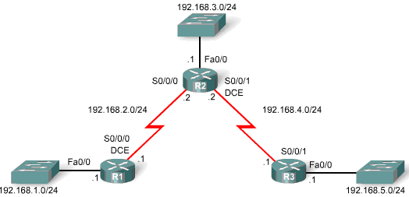
IOS RIPv1 configuration
Router(config-router)#network directly-connected-classful-network-address
Enables RIP on all interfaces that belong to a specific network. Associated interfaces will now both send and receive RIP updates.
Advertises the specified network in RIP routing updates
R3(config)#router rip
R3(config-router)#network 192.168.4.0
R3(config-router)#network 192.168.5.1
R3(config-router)#exit
R3#show running-config
!
router rip
network 192.168.4.0
network 192.168.5.0
!
Notes:
By entering the RIP router configuration mode, the router is instructed to run RIP. But the router still needs to know which local interfaces it should use for communication with other routers, as well as which locally connected networks it should advertise to those routers. To enable RIP routing for a network, use the network command in the router configuration mode and enter the classful network address for each directly connected network.
Router(config-router)#network directly-connected-classful-network-address
The network command:
Enables RIP on all interfaces that belong to a specific network. Associated interfaces will now both send and receive RIP updates.
Advertises the specified network in RIP routing updates sent to other routers every 30 seconds.
Note: If you enter a subnet address, the IOS automatically converts it to a classful network address. For example, if you enter the command network 192.168.1.32, the router will convert it to network 192.168.1.0.

Slide 22
Test 2
Configure RIP as routing protocol
Check connectivity between hosts
Save the configuration
Use wireshark to check traffic

Slide 23
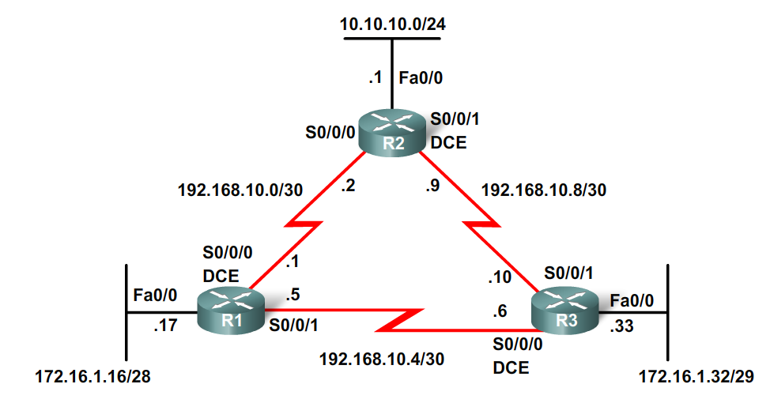
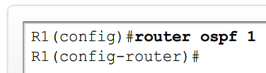
Configuring OSPF
Enabling OSPF routing
Default bandwidth 1544kbps on all serial links
Router(config)#router ospf process-id
Notes:
Discontiguous networks, multiple paths, single area
OSPF is enabled with the router ospf process-id global configuration command. The process-id is a number between 1 and 65535 and is chosen by the network administrator. The process-id is locally significant, which means that it does not have to match other OSPF routers in order to establish adjacencies with those neighbors. This differs from EIGRP. The EIGRP process ID or autonomous system number does need to match for two EIGRP neighbors to become adjacent.
In our topology, we will enable OSPF on all three routers using the same process ID of 1. We are using the same process ID simply for consistency.

Slide 24
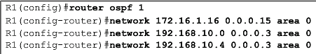
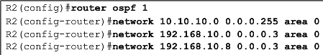
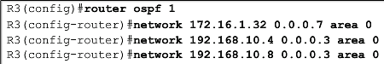
Configuring OSPF
Router(config-router)#network network-address wildcard-mask area area-id
Configuring OSPF subnetworks
Any interface matching the network address will be enabled to send and receive OSPF packets
This network (or subnet) will be included in OSPF routing updates
Notes:
The network command used with OSPF has the same function as when used with other IGP routing protocols:
Any interfaces on a router that match the network address in the network command will be enabled to send and receive OSPF packets.
This network (or subnet) will be included in OSPF routing updates.
The network command is used in router configuration mode.
Router(config-router)#network network-address wildcard-mask area area-id
The OSPF network command uses a combination of network-address and wildcard-mask similar to that which can be used by EIGRP. Unlike EIGRP, however, OSPF requires the wildcard mask. The network address along with the wildcard mask is used to specify the interface or range of interfaces that will be enabled for OSPF using this network command.
As with EIGRP, the wildcard mask can be configured as the inverse of a subnet mask. For example, R1's FastEthernet 0/0 interface is on the 172.16.1.16/28 network. The subnet mask for this interface is /28 or 255.255.255.240. The inverse of the subnet mask results in the wildcard mask.
Note: Like EIGRP, some IOS versions allow you to simply enter the subnet mask instead of the wildcard mask. The IOS then converts the subnet mask to the wildcard mask format.
255.255.255.255
- 255.255.255.240 Subtract the subnet mask
--------------------
0. 0. 0. 15 Wildcard mask
The area area-id refers to the OSPF area. An OSPF area is a group of routers that share link-state information. All OSPF routers in the same area must have the same link-state information in their link-state databases. This is accomplished by routers flooding their individual link-states to all other routers in the area. In this chapter, we will configure all of the OSPF routers within a single area. This is known as single-area OSPF.
An OSPF network can also be configured as multiple areas. There are several advantages to configuring large OSPF networks as multiple areas, including smaller link-state databases and the ability to isolate unstable network problems within an area. Multi-area OSPF is covered in CCNP.
When all of the routers are within the same OSPF area, the network commands must be configured with the same area-id on all routers. Although any area-id can be used, it is good practice to use an area-id of 0 with single-area OSPF. This convention makes it easier if the network is later configured as multiple OSPF areas where area 0 becomes the backbone area.
The figure shows the network commands for all three routers, enabling OSPF on all interfaces. At this point all routers should be able to ping all networks.

Slide 25
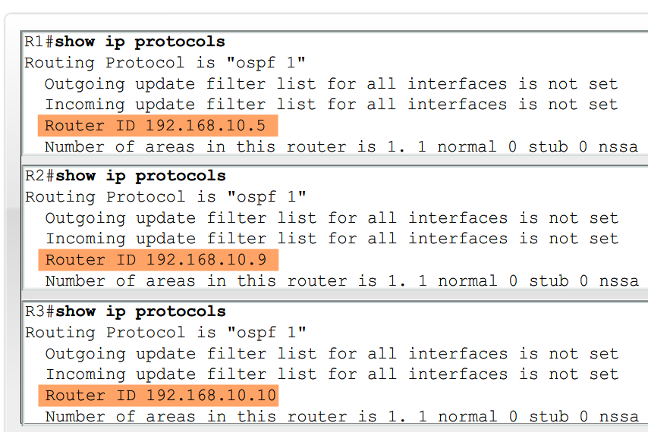
Configuring OSPF
Determining the router id
IP address configured with the router-id command
The highest IP address of any of its loopback interfaces
The highest active IP address of any of its physical interfaces
Router(config-router)#router-id ip-address
Notes:
Determining the Router ID
The OSPF router ID is used to uniquely identify each router in the OSPF routing domain. A router ID is simply an IP address. Cisco routers derive the router ID based on three criteria and with the following precedence:
Use the IP address configured with the OSPF router-id command.
If the router-id is not configured, the router chooses highest IP address of any of its loopback interfaces.
If no loopback interfaces are configured, the router chooses highest active IP address of any of its physical interfaces.
Highest Active IP Address
If an OSPF router is not configured with an OSPF router-id command and there are no loopback interfaces configured, the OSPF router ID will be the highest active IP address on any of its interfaces. The interface does not need to be enabled for OSPF, meaning that it does not need to be included in one of the OSPF network commands. However, the interface must be active - it must be in the up state.

Slide 26
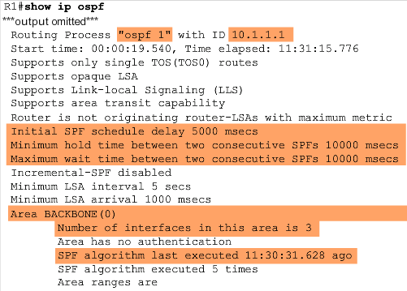
Verifying OSPF configuration
OSPF troubleshooting commands
show ip protocols
show ip ospf
show ip ospf interface
Notes:
Other powerful OSPF troubleshooting commands include:
show ip protocols
show ip ospf
show ip ospf interface
As shown in the figure, the show ip protocols command is a quick way to verify vital OSPF configuration information, including the OSPF process ID, the router ID, networks the router is advertising, the neighbors the router is receiving updates from, and the default administrative distance, which is 110 for OSPF.
The show ip ospf command can also be used to examine the OSPF process ID and router ID. Additionally, this command displays the OSPF area information as well as the last time the SPF algorithm was calculated. As you can see from the sample output, OSPF is a very stable routing protocol. The only OSPF-related event that R1 has participated in during the past 11 and a half hours is to send small Hello packets to its neighbors.
Note: Additional information displayed by the show ip ospf command is discussed in CCNP courses.
The command output includes important SPF algorithm information which includes the SPF schedule delay:
Initial SPF schedule delay 5000 msecs
Minimum hold time between two consecutive SPFs 10000 msecs
Maximum wait time between two consecutive SPFs 10000 msecs
Any time a router receives new information about the topology (addition, deletion, or modification of a link), the router must rerun the SPF algorithm, create a new SPF tree, and update the routing table. The SPF algorithm is CPU-intensive and the time it takes for calculation depends on the size of the area. The size of an area is measured by the number of routers and the size of the link-state database.
A network that cycles between an up state and a down state is referred to as a flapping link. A flapping link can cause OSPF routers in an area to constantly recalculate the SPF algorithm, preventing proper convergence. To minimize this problem, the router waits 5 seconds (5000 msecs) after receiving an LSU before running the SPF algorithm. This is known as the SPF schedule delay. In order to prevent a router from constantly running the SPF algorithm, there is an additional Hold Time of 10 seconds (10000 msecs). The router waits 10 seconds after running the SPF algorithm before rerunning the algorithm again.
The quickest way to verify Hello and Dead intervals is to use the show ip ospf interface command. As shown in the figure, adding the interface name and number to the command displays output for a specific interface. These intervals are included in the OSPF Hello packets sent between neighbors. OSPF may have different Hello and Dead intervals on various interfaces, but for OSPF routers to become neighbors, their OSPF Hello and Dead intervals must be identical. For example, in the figure, R1 is using a Hello interval of 10 and a Dead interval of 40 on the Serial 0/0/0 interface. R2 must also use the same intervals on its Serial 0/0/0 interface or the two routers will not form an adjacency.

Slide 27
Test 3
Configure OSPF as routing protocol
Check connectivity between hosts
Save the configuration
Use wireshark to check traffic

Slide 28
Base Network
Antonio Virdis
Assistant Professor@ University of Pisa
antonio.virdis@unipi.it

Slide 29
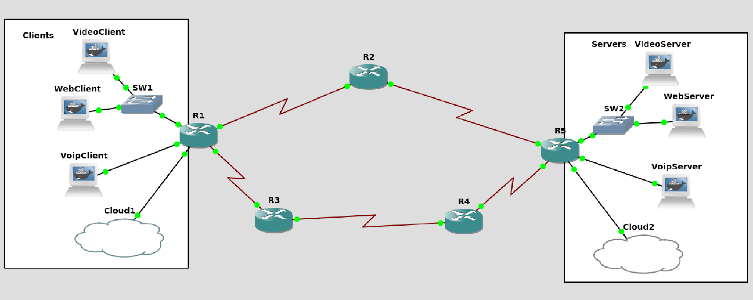
Network Architecture
192.168.1.0/24
10.1.1.0/30
s1/0
.2
s1/1
.1
192.168.101.0/24
e1/0
.1
10.5.5.0/30
s2/0
.1
e1/1
.1
S2/1
.2
e2/0
.1
192.168.2.0/24
s2/1
.1
e2/1
.1
192.168.102.0/24
s2/0
.2
e1/2
.1
e2/2
.1
s1/0
.2
S1/1
.1
s1/1
.1
10.4.4.0/30
s1/0
.2
192.168.3.0/24
10.2.2.0/30
10.3.3.0/30
192.168.103.0/24
tapX is a virtual network interface exposed on the Linux OS to provide a point of access to the emulated network
Linux OS
tap0
Linux OS
tap1

Slide 30
IPv6 Configuration
Antonio Virdis
Assistant Professor@ University of Pisa
antonio.virdis@unipi.it

Slide 31
IPv6 address configuration
Configuration:
interface Ethernet0/0
ipv6 enable
(Automatically configure an IPv6 link-local address on the interface, and enable the interface for IPv6 processing)
ipv6 address 2001:aaaa:bbbb:cccc::/64 eui-64
ipv6 unicast-routing
Enable forwarding of IPv6 unicast data packets
Check configuration status:
show ipv6 interface Ethernet0/0

Slide 32
IPv6 host configuration
Go to Linux Console 1:
ifconfig
Address already obtained! When a Router Advertisement is received by a client, and IPv6 autoconfiguration is enabled (default on non-router), the client configures itself an IPv6 address according to the prefix contained in the advertisement.
Ping:
ping6 [IPv6 address]
From Host, try both link-local and global
Use wireshark to see what’s going on the net!

Slide 33
RIPv6 Configuration
Configuration:
ipv6 unicast-routing
Enable forwarding of IPv6 unicast data packets
interface fastEthernet0/0
From Host, try both link-local and global
ipv6 rip process1 enable
Check IPv6 Routing Table
show ipv6 route

Slide 34
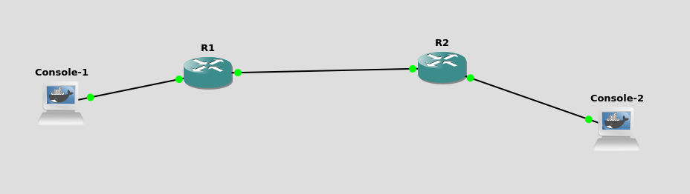
Test 4
2001:DEAD:100::1/64
2001:DEAD:200::1/64
2001:DEAD:500::1/64

Slide 35
Infrastructure QoS support
Antonio Virdis
Assistant Professor@ University of Pisa
antonio.virdis@unipi.it

Slide 36
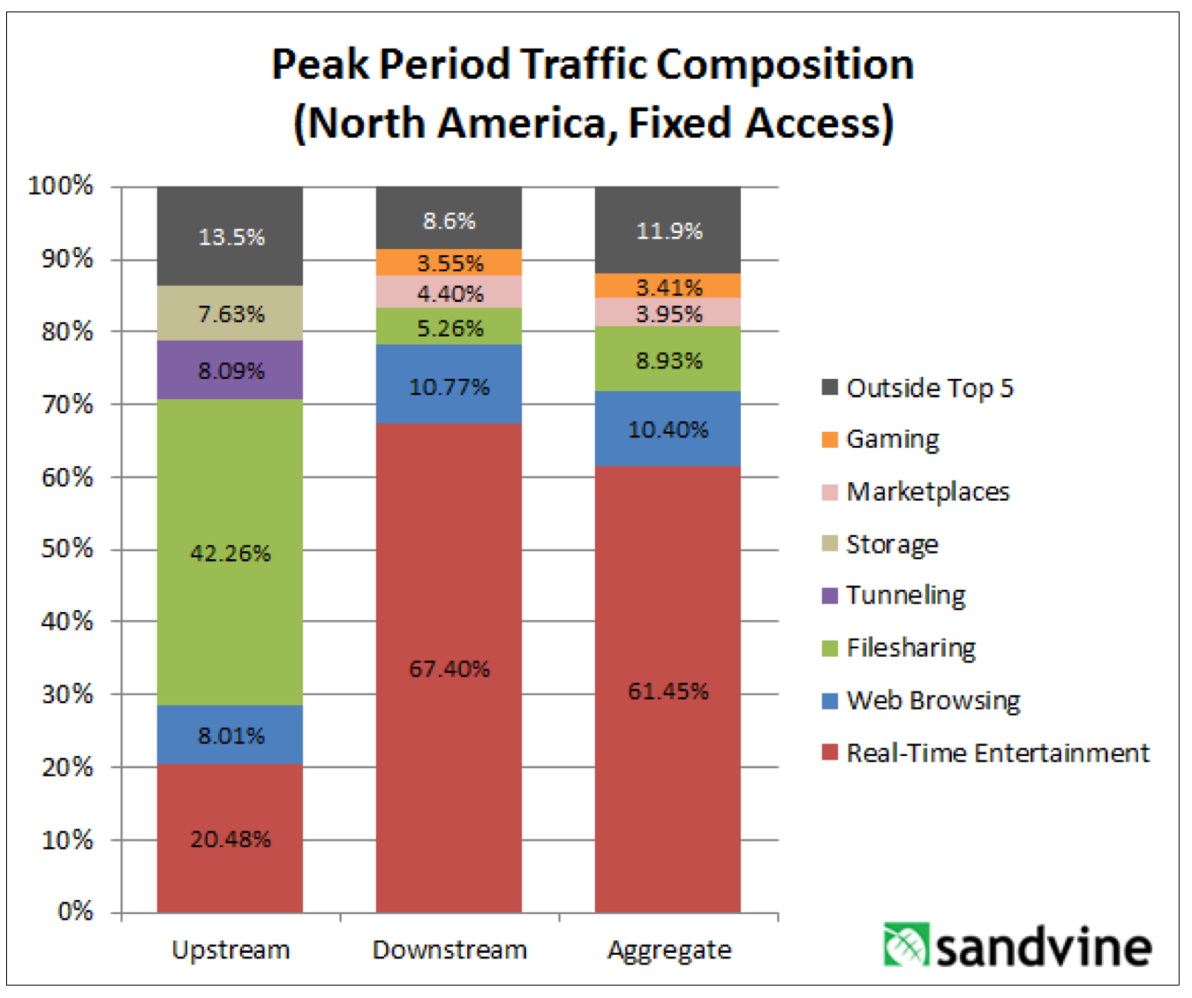
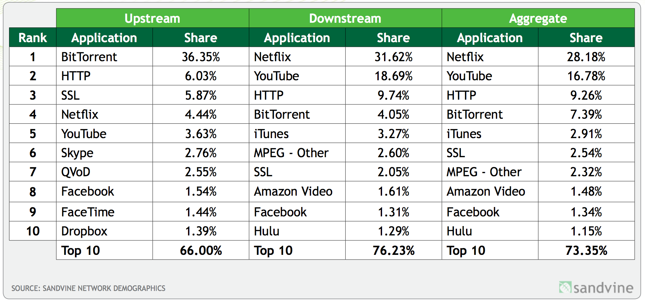

Slide 37
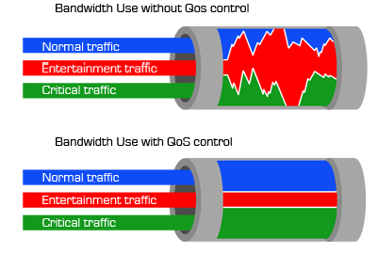

QoS in the Internet
E.g. VoIP requires packets to be delivered with a delay which is in the worst case in the order of 150ms one-way

